Slide 1
GMIN 317 – Moteur de Jeux Intelligence artificielle pour le jeu vidéo
Rémi Ronfard
Remi.ronfard@inria.fr
https://team.inria.fr/imagine/remi-ronfard/

Slide 2
Cette présentation va s’intéresser aux différentes techniques d’intelligence artificielle utilisées dans les moteurs de jeu.
Surtout sur le plan des méthodes génériques d’utilisation courante.
Ce cours est largement inspiré des cours de Marc Moulis et Benoit Lange.

Slide 3
Personnages non-joueurs (non-player characters)
Comportements d’un personnage non joueur
Attaque, fuite, poursuite, patrouille
Recherche de chemins
Imitation/adaptation
Expression de sentiments
Apprentissage
Interaction avec les autres personnages
Tous contrôlés par intelligence artificielle
A chaque boucle du jeu (très vite)

Slide 4
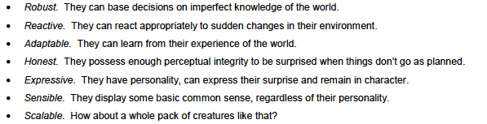
Qualités de l’IA des personnages non-joueurs

Slide 5
Plan du cours
Recherche de chemins
Machines d’états finis
Planification et sélection d’actions
Arbres de comportements
Intelligence artificielle des SIMS
Personnalités et jeux sociaux

Slide 6
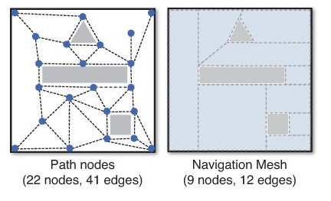
Path nodes et navigation meshes

Slide 7
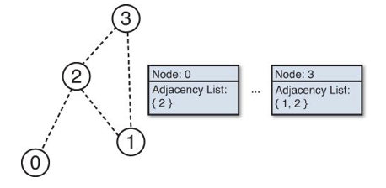
Graphe de parcours

Slide 8
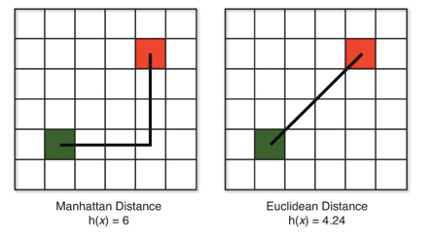
Recherche de plus courts chemins
La longueur d’un chemin est supérieure à la distance de Manhattan, qui est supérieure à la distance Euclidienne

Slide 9
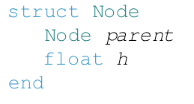
Arbre de parcours du graphe
OpenSet : Noeuds à évaluer, par ordre de distance croissante (file de priorité)
ClosedSet : Noeuds déjà évalués (arbre binaire)

Slide 10
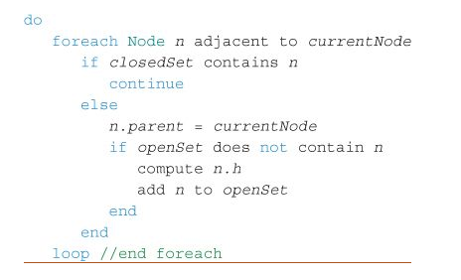
Parcours « best-first »

Slide 11
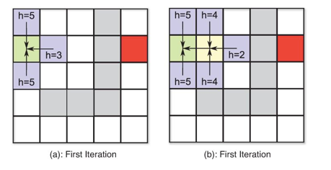
Parcours best-first

Slide 12
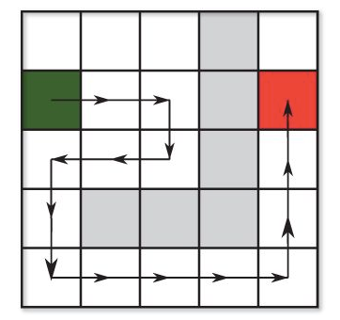
Recherche heuristique

Slide 13
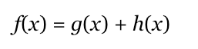
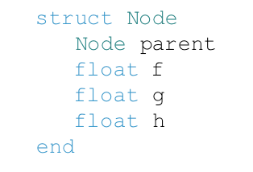
Algorithme A*
Meilleure estimation de la distance totale
Révision du meilleur chemin

Slide 14
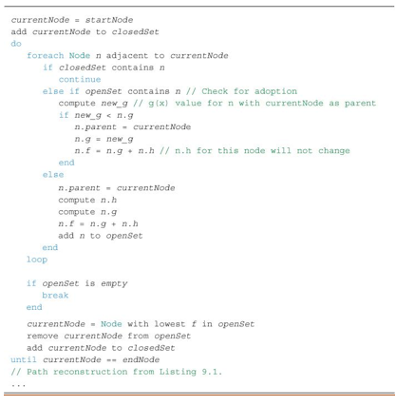
Algorithme A*

Slide 15
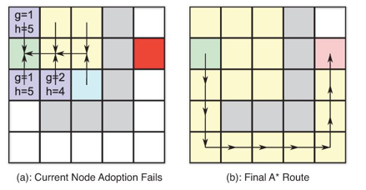
Exemple

Slide 16
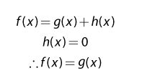
Algorithme de Dijkstra
Avantage : trouve toutes les solutions
Inconvénient : parcourt tous les chemins possibles

Slide 17
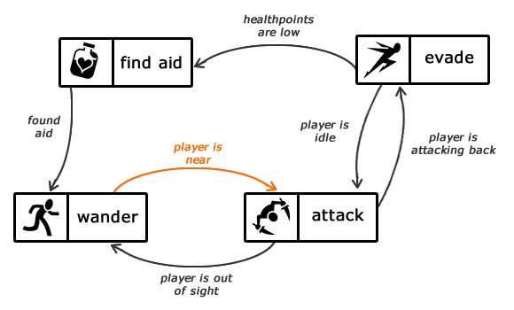
Machines d’états finis

Slide 18
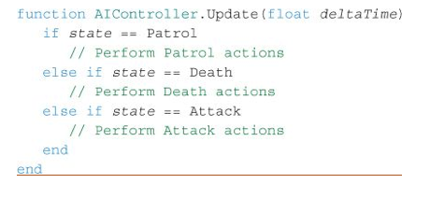
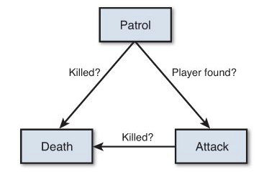
Exemple de machine d’états finis

Slide 19
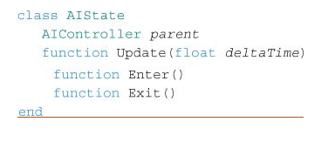
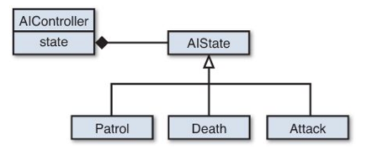
Exemple d’implémentation

Slide 20
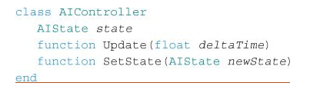
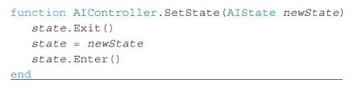
Exemple d’implémentation

Slide 21
Goal-oriented action planning (GOAP)
Goal-Oriented Action Planning (aka GOAP, rhymes with soap) refers to a simplfied STRIPS-like planning architecture specifically designed for real-time control of autonomous character behavior in games.
JEFF ORKIN originally implemented GOAP for F.E.A.R. while working at Monolith Productions.
GOAP was inspired by the Synthetic Characters Group's C4 agent architecture at the MIT Media Lab, and Nils Nilsson's description of STRIPS planning in his AI book.

Slide 22
Goal-oriented action planning (GOAP)
Goal oriented action planning is an artificial intelligence system for agents that allows them to plan a sequence of actions to satisfy a particular goal.
The particular sequence of actions depends not only on the goal but also on the current state of the world and the agent.
This means that if the same goal is supplied for different agents or world states, you can get a completely different sequence of actions, which makes the AI more dynamic and realistic.

Slide 23
GAMES USING GOAP ARCHITECTURES
F.E.A.R. (X360/PS3/PC) - Monolith Productions/VU Games, 2005
Condemned: Criminal Origins (X360/PC) - Monolith Productions/Sega, 2005
S.T.A.L.K.E.R.: Shadow of Chernobyl (PC) - GSC Game World/THQ, 2007
Mushroom Men: The Spore Wars (Wii) - Red Fly Studio, 2008
Ghostbusters (Wii) - Red Fly Studio, 2008
Silent Hill: Homecoming (X360/PS3) - Double Helix Games/Konami, 2008
Fallout 3 (X360/PS3/PC) - Bethesda Softworks, 2008
Empire: Total War (PC) - Creative Assembly/SEGA, 2009
F.E.A.R. 2: Project Origin (X360/PS3/PC) - Monolith Productions/Warner Bros, 2009
Demigod (PC) - Gas Powered Games/Stardock, 2009
LMNO (working title) (X360/PS3) - Electronic Arts
Just Cause 2 (PC/X360/PS3) - Avalanche Studios/Eidos Interactive, 2010
Transformers: War for Cybertron (PC/X360/PS3) - High Moon Studios/Activision, 2010
Trapped Dead (PC) - Headup Games, 2011
Deus Ex: Human Revolution (PC/X360/PS3) - Eidos Interactive, 2011

Slide 24
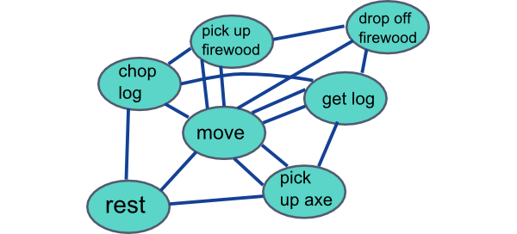
Goal-oriented action planning (GOAP)

Slide 25
Goal-oriented action planning (GOAP)
GOAL: "make firewood"
Current State: "doesn’t have an axe", "an axe is available"
Can action ChopLog run?
NO - requires precondition "has an axe"
Cannot use it now, try another action.
Can action GetAxe run?
YES, preconditions "an axe is available" and "doesn’t have an axe" are true.
PUSH action onto queue, update state with action’s effect
New State
"has an axe"
Remove state "an axe is available" because we just took one.
Can action ChopLog run?
YES, precondition "has an axe" is true
PUSH action onto queue, update state with action’s effect
New State
"has an axe", "makes firewood"
We have reached our GOAL of "makes firewood"
Action sequence: GetAxe -> ChopLog

Slide 26
Arbres de comportements
Arbres de comportements (Behavior Trees)
Utilisés dans Halo, Spore, etc.
Décomposition hiérarchique des comportements (ET/OU)
Décomposition séquentielle des comportements
Branches de l’arbre sont des conditions à tester et des actions à exécuter

Slide 27
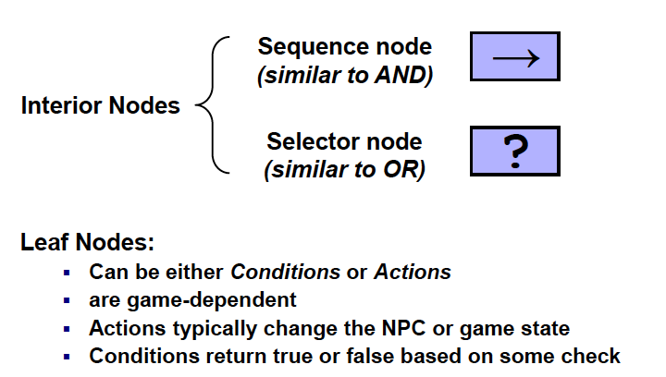
Arbres de comportements

Slide 28
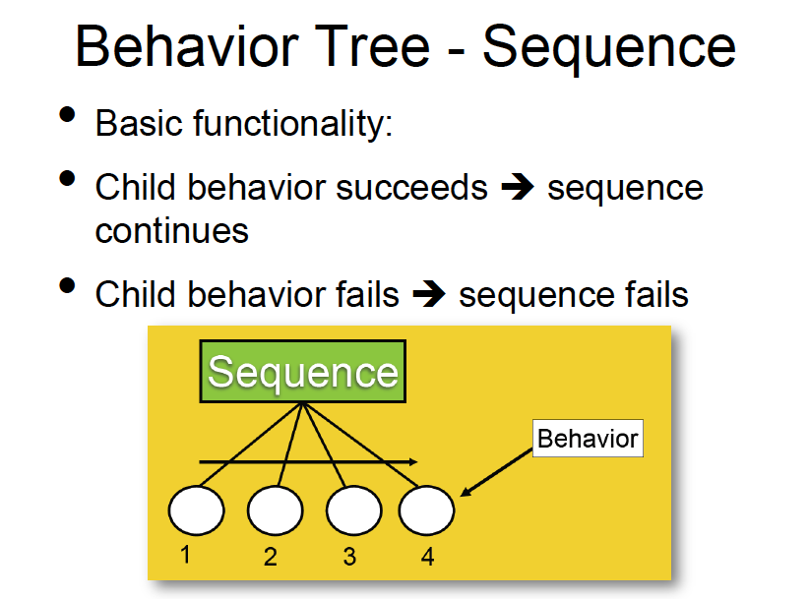
Arbres de comportements

Slide 29
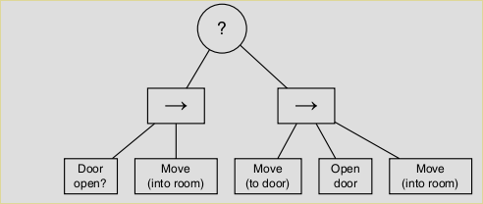
Exemple d’arbre de comportement

Slide 30
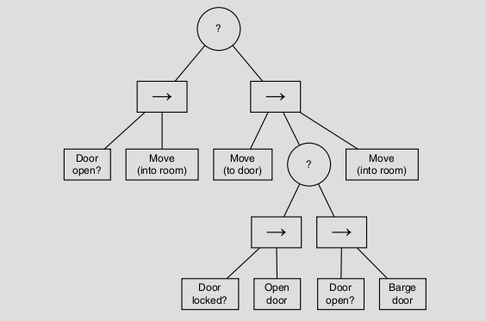
Exemple d’arbre de comportement

Slide 31
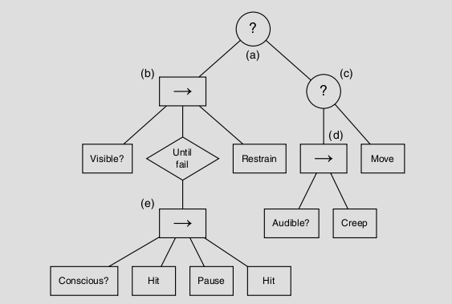
Exemple d’arbre de comportement

Slide 32
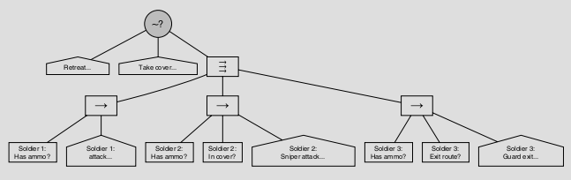
Arbres de comportement : Parallel Nodes

Slide 33

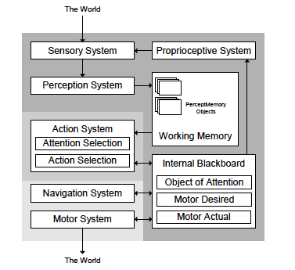

Slide 34
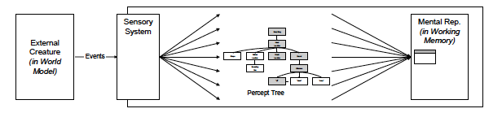
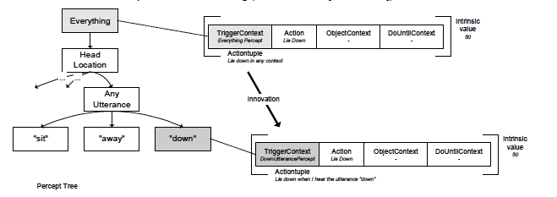

Slide 35
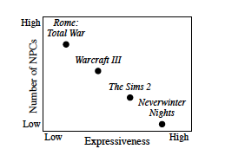
Passage à l’échelle
Source: White et al. Scaling games to epic proportions. SIGMOD 2007.

Slide 36
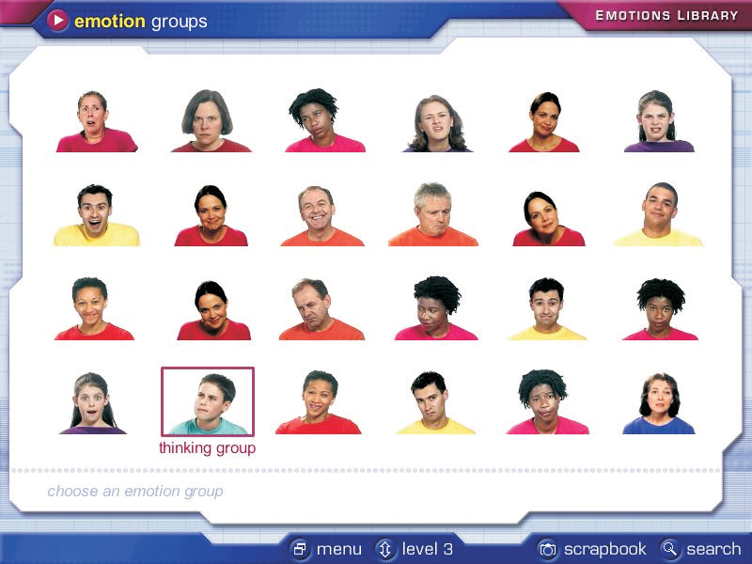
Expressivité
Afraid Angry Bored Bothered Disbelieving Disgusted
Excited Fond Happy Hurt Interested Kind
Liked Romantic Sad Sneaky Sorry Sure
Surprised Thinking Touched Unfriendly Unsure Wanting

Slide 37
Levels expressifs/émotionnels
level 1: equivalent to a typical 4 to 7-year-old
level 2: equivalent to a typical 8 to 10-year-old
level 3: equivalent to a typical 11 to 13 -year-old
level 4: equivalent to a typical 14 to 16-year-old
level 5: equivalent to a typical 17 to 18-year-old
level 6: suitable for an advanced user (typically an adult).
Source: Mindreading Emotions Library, Univ. Cambridge.

Slide 38
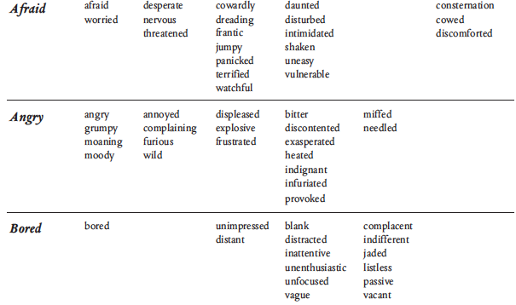
Emotions et niveaux

Slide 39
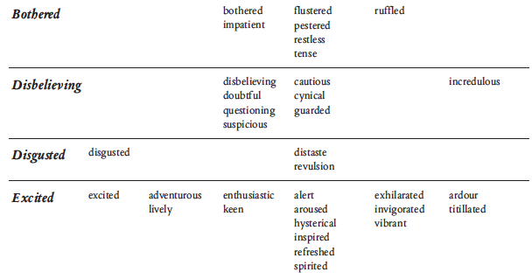
Emotions et niveaux

Slide 40
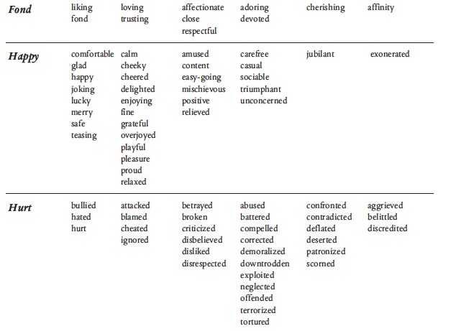
Emotions et niveaux

Slide 41
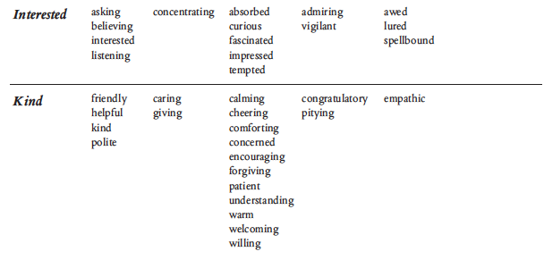
Emotions et niveaux

Slide 42
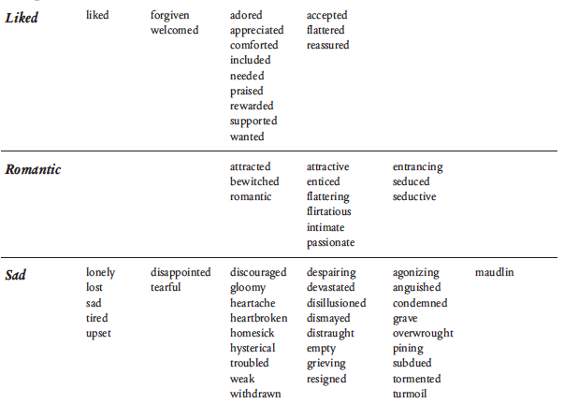
Emotions et niveaux

Slide 43
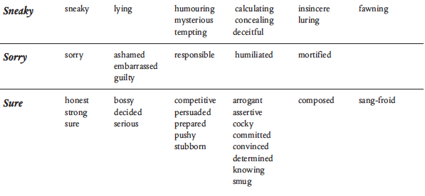
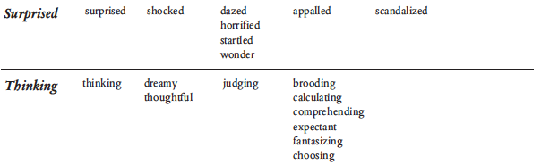
Emotions et niveaux

Slide 44
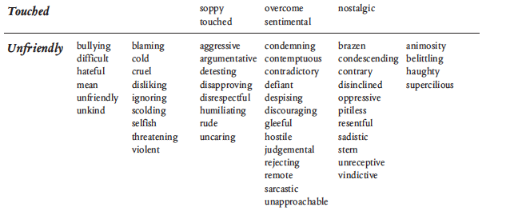
Emotions et niveaux

Slide 45
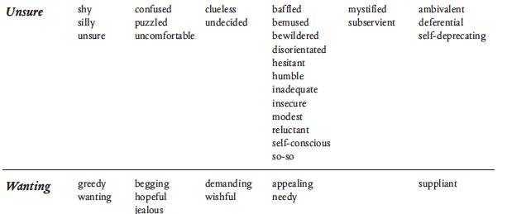
Emotions et niveaux

Slide 46
Cinématographie et montage intelligents
Virtual Cinematography Theory and Practice for Automatic Real-Time Camera Control and Directing
By Liwei He, Microsoft Research
http://research.microsoft.com/users/lhe

Slide 47
L’IA des SIMS

Slide 48
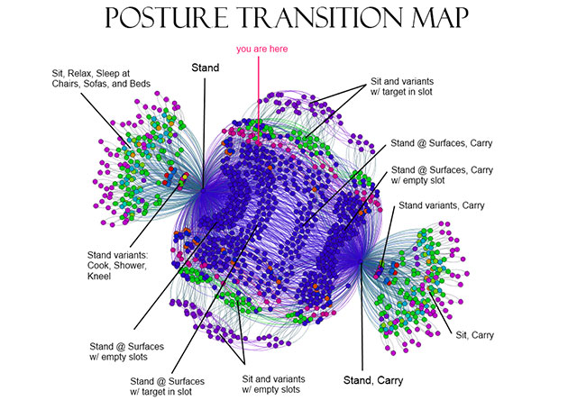

Slide 49

Intelligence artificielle des SIMS
Modeling individual personalities (Richard Evans)

Slide 50
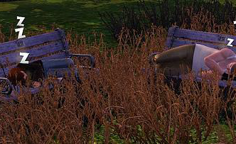
Emergent narrative : Alice and Kev by Robin Burkinshaw

Slide 51

Kev, the father, is mean-spirited and highly inappropriate

Slide 52

Alice, his daughter, is sweet, kind, forgiving

Slide 53
Intelligence artificielle des SIMS
Planification hiérarchique
Carte des buts et interactions
Décisions non déterministes
Personalités et motivations
Actes de langages et situations sociales
Progression narrative et dramaturgie

Slide 54
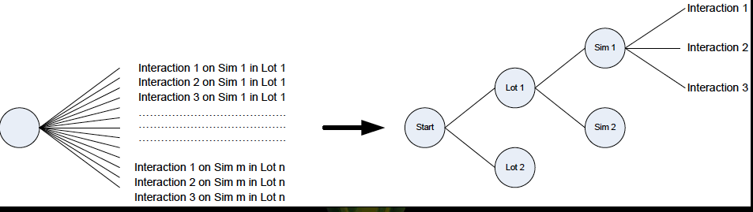
Planification hiérarchique
Réduire le nombre de choix
for each lot l
for each agent x in l
for each social interaction a on x
consider performing a on x
Choose which lot to go to: l
Then choose which agent to talk to in l : x
Then choose which social interaction to perform : a

Slide 55
Commodity-interaction maps
Sims 1 & 2 :
for each interaction a on each object x
check if a is currently available on x
if so, work out how much I want to do a
Sims 3 :
Consulter une « carte » des buts (commodities) et actions associées

Slide 56
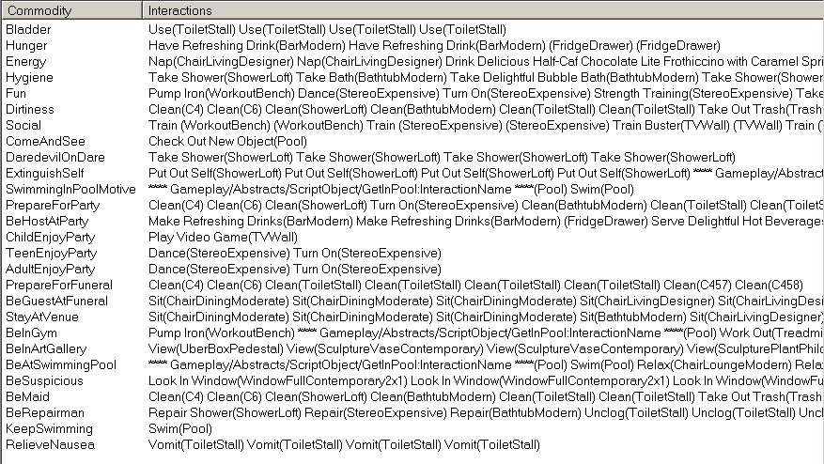
Commodities and interactions

Slide 57
Comment les SIMS décident-ils de leurs actions ?
Calculer l’utilité (score) de toutes les actions possibles
Choisir avec une probabilité p = exp(S/T) -1
T is the temperature
This is a simplified Boltzmann function
Temperature should be cool when he is happy, and should go up when the Sim is doing badly

Slide 58
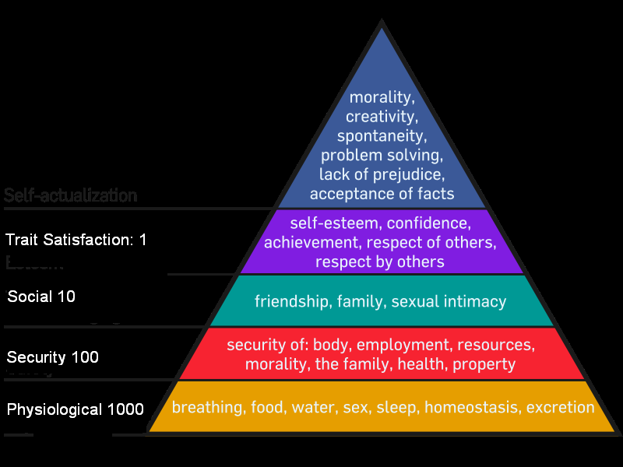
Hiérarchie des motivations de Maslow

Slide 59
Motivations et traits de personalité
In Sims 1 & 2, every Sim had the same 8 motives
In Sims 3, each Sim has a different set of motives, based on his traits
But the set of motives doesn’t just vary between individuals, it also varies within the same individual over time
We add and remove motives through time, to model a Sim’s understanding of social norms

Slide 60
Jeu vidéo et interaction sociale
Sims 1 and 2 had very broad speech-acts
Talk, Joke
In Sims 3, we have more specific social speech-acts
Compliment Home, Worry About Relationship
These fine-grained social speech-acts allow us to express our fine-grained personalities

Slide 61
Traits affect which social interactions they choose autonomously
Snobs like to boast about their cars
Neurotic Sims will accuse their partner of cheating on them
If a mean-spirited Sim finds out the person he is talking to is a vegetarian, he is apt to mock her vegetarianism!

Slide 62

Les SIMS agissent en fonction de leurs personnalités et des situations sociales

Slide 63

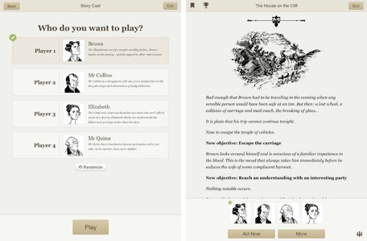

Social games beyond the SIMS
Mass Effect
Versu (Richard Evans, Emily Short)
Heavy Rain (David Cage, Quantic Dream, Paris)
Facade (Michael Mateas)

Slide 64
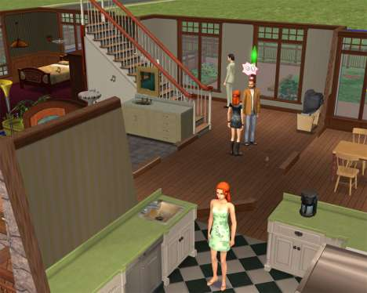
Living with the SIMS: Smart Objects

Slide 65
1) Make Your Objects Self-Contained
In The Sims 2, all the data relating to objects is stored together. According to Jake Simpson [1], Lead Simulation Engineer, this includes:
“Localized string lists, executable scripts, common definition meta data, animation lists, routing information, advertising information, interaction definitions, model information.”
A one-stop resource for any information relating to objects is very useful to have both during development and at runtime. It makes the whole game much more modular, which explains how easy it is for EA to build expansion packs!

Slide 66
2) Use Micro-Threads for Objects
Because there are so many objects collaborating together to form the gameplay, it’s important to make sure they all get a share of the computation time if necessary. In The Sims, this is done using cooperative scheduling.
Each object has its own micro-thread for execution which gets updated each frame if necessary. The scripting language supports features to help these threads cooperate with the game engine, for example a yield instruction to wait for the path-finder, animation system, or even a timer.

Slide 67
3) Automate Handling of Objects
Because there are so many objects and they are usable modularly, the game engine must handle them automatically without any special instructions. When a new object is inserted into the game:
The initialization function of the object is executed.
Each frame, the object’s main update function is called.
This differs from the majority of games where objects either contain no logic, or the functionality is implemented centrally in the engine. The advantage of this approach is that extending the game requires fewer changes to the engine (if any).

Slide 68
4) Use Objects Uniformly Everywhere
With an object model as powerful as the one in The Sims, it makes sense to use it extensively throughout the game. And indeed, objects are used practically everywhere. They fall into two categories:
Physical — Cars, chairs, electronics, gadgets, toys, toilets, etc.
Abstract — Objects to handle visitors arriving on the lot, change the weather, track time of day, etc.
The only requirement for an “object” is that it conforms to the common API, so its code is executed every frame.

Slide 69
5) Add Advertising Data to Objects
Each object has a public interface that broadcasts its functionality to actors in the game. This is called advertising data in The Sims, and contains a list of possible actions and what motives they satisfy.
For example:
Using the toilet satisfies the bladder and increases comfort.
Cleaning the toilet improves the atmosphere in the room.
This information is used by the decision-making code (discussed below) to pick the next object an actor uses autonomously.

Slide 70
6) Store Assets Separately
Despite objects being self-contained, certain assets are stored separately when necessary. Specifically, this prevents duplication of animation data, textures, or models. The references to these assets are still contained in the object itself, but they are saved in a common location.

Slide 71
7) Use an Excel Sheet to Store Properties Centrally
This is another exception to the objects being self-contained, but it makes things more convenient. When tweaking the game, whether in the final stages before shipping or during prototyping, it’s convenient to have a complete overview of the game in one place.
In The Sims, a large Excel sheet is used to store the properties of the objects. When the game is built, the information is copied over to each object individually, but the values can be adjusted centrally without having to search for each object.

Slide 72
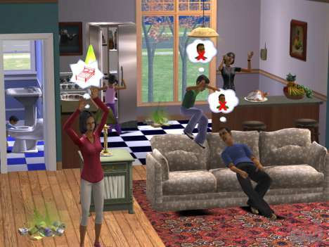
Living with the SIMS: Development Process

Slide 73
8) Formalize the Development Process
When you have a modular object system, it becomes possible to treat new features one object at a time. During the development of The Sims 2 and its expansion pack, there was a very clear development process [1]:
Design meeting about the object to decide what motives it satisfies, if it needs repairing, if there are other similar objects in a group, how it fits with the theme.
Technical meeting to define the scope of the object, what’s necessary to implement it (in terms of art assets and scripts), and also if additional engine support is required.
Scheduling can take place to plan the workload required to get the asset into the game. This is typically a collaboration between script engineers and artists.
This process makes it much more predictable to build smart objects, so the environments are more likely to be interesting and varied.

Slide 74
9) Invest in Home Grown Tools
The custom tool behind the smart objects in The Sims is known as Edith. The developers decided it was worth the trade-off to invest in their own technology.
Advantages — It’s easier to make changes to suit the gameplay and workflow.
Disadvantages — It takes more time, skills are not transferable.
These days, most developers prefer reusing an existing language, but for very specific problems it still makes sense to roll your own.

Slide 75
10) Focus on Powerful Development Tools
Regardless of whether they are made in-house or not, it’s important to have a good set of tools for working with the scripts. Edith provides the developers with:
Live debugging.
Code and data breakpoints.
Edit and continue.
Profiling functionality.
Having a home grown toolset makes it easier to implement these features, which decreases turn around times. It’d be much harder to build these features on top of an existing language.

Slide 76
11) Make the Editor In-Game
The Edith editor is completely in-game. This has the advantage that scripts can be updated in real-time and the changes are visible immediately. This not only helps improve turn-around times, but the behaviors of the objects are also better tweaked.
The disadvantage of this approach is that it relies on a working build. If the build breaks, the editor is no longer functional, and progress on the game stops. Extra precautions must be taken to assure this doesn’t happen.

Slide 77
12) Create Audio After the Animations
In most games, the sound effects are annotated onto the animations. There are markers in the animation data that indicate when a sound should be played.
The Sims apparently uses one sound per animation. Since the timing is important, the audio can only be created after the animation.

Slide 78
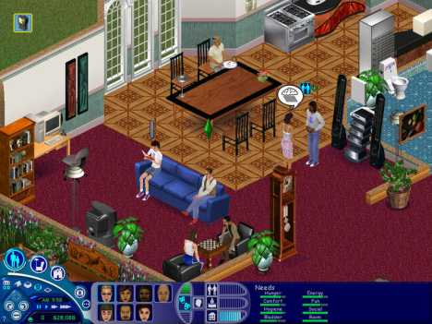
Living with the SIMS: Custom Scripting Language

Slide 79
13) Use an Interpreted Language
The script data is loaded up and executed by an interpreter, as opposed to natively compiled code that is run on the processor directly. This is an interesting compromise:
Speed: It’s much slower to parse at runtime but it avoids the need for compilation during the build.
Extensibility: It’s easier to extend an interpreter than to rework a compiler.
Interactivity: The interpreter is required to implement edit and continue.
In The Sims, the developers decided to implement only an interpreter (a closer fit to their requirements), rather than maintain a separate compiler as well.

Slide 80
14) Use a Binary File Format for Scripts
The advantage of having a custom interpreted language is that it’s much harder to reverse-engineer. The Sims tries to take this even further by storing the scripts in a binary format, similarly to byte-code rather than providing the whole source code for the scripts to the end user.

Slide 81
15) Optimize the Scripting Language API
The custom language developed by EA/Maxis was specifically tailored for realtime performance. Specifically:
There are no heavy trigonometry functions.
All computations are done relatively to the object in space.
The scripts rely on the engine for the heavy calculations.
There are time limits on the computation of each object per frame.
These restrictions make it easier to guarantee good performance with the cooperative scheduling despite potential problems with isolated scripts.

Slide 82
16) Integrate the Scripts into the Engine Tightly
In many games, the scripting engine serves as a high-level logic that controls actors in the game. However, for The Sims, the scripting functionality is very tightly integrated into the engine itself.
For example, script functions in the objects can be called by the core decision-making system. This allows the actors to take into account the properties of each object according to their own properties (e.g. a toy is only fun if you’re not very old).

Slide 83
17) Implement Error Recovery Mechanisms
When a script crashes or a problem is detected by the interpreter, the object is reset to a known state (e.g. the initial state). This means the game can continue without affecting the player’s experience.
The scripts for the actors are handled similarly. When a problem occurs, the actor is reloaded from the last save, and repositioned in the world.

Slide 84
18) Inherit Scripts Hierarchically
The Sims uses a form of inheritance to help reuse code. This is done according to the file system: the closer towards the root directory the more general the code (e.g. global scripts), and specific objects are in the leaves.
This helps create expansion packs, as different directories may override the base file system. Any game with a Quake-like PAK archiving system supports file system extensions, but this needs to be integrated with the scripting engine.

Slide 85

Living with the SIMS: Character AI

Slide 86
19) Use Response Curves to Model Emotions
A form of fuzzy logic is used to model the emotions of the actors. Each of them have basic feelings measured in the range [-100,100], specifically:
Physical: Hunger, comfort, hygiene, and bladder.
Emotional: Energy, fun, social, and room.
Each of these are mapped to a mood/happiness value using a response curve.
Some functions are linear mappings, e.g. hygiene and energy to happiness, but others are polynomial functions. For example, the more hungry actors get the less they care about anything else!

Slide 87
20) Try Greedy Decision Making
Given these basic feelings, the decision-making part of the AI is responsible for finding objects that fulfill their current needs. This is done based on multiple factors:
The actions possible based on the objects that are available.
The reward that each action provides to the current actor.
The distance of the object to the current location.
The level of need felt by the actor at the time.
This can be implemented using a voting system, whereby the most valuable object according to all feelings is used next by the autonomous behaviors.

Slide 88
21) Make Canned Plans
The behavior of the actors in The Sims is very much a by-product of the decision making and the smart objects. As such, they don’t really do much intelligent reasoning. In fact all their plans are “canned,” meaning they are specified manually using scripts.
For example, the process of preparing lunch may require multiple steps, but each of them is specified via a script attached to the fridge. In a sense, there is very little intelligence in the actors themselves, hence the “smart object” terminology!

Slide 89
References
[1] Scripting and Sims2: Coding the Psychology of Little People. Jake Simpson, Game Developer's Conference 2005.
[2] Under the Hood of the Sims. Kenneth D. Forbus, CS 395 Game Design, 2002.

Slide 90
Character design space
Individuality
Physical & Social
Dynamics
Visual
Concreteness

Slide 91
Character design space
Individuality
Heavy Rain
Physical & Social
Dynamics
Visual
Concreteness

Slide 92
Character design space
Individuality
Mass Effect (physical medium, social low)
Physical & Social
Dynamics
Visual
Concreteness

Slide 93
Character design space
Individuality
Sims 3
Physical & Social
Dynamics
Visual
Concreteness

Slide 94
Character design space
Individuality
Façade
(social/communicative high, physical low)
Physical & Social
Dynamics
Visual
Concreteness

Slide 95
Zoomed in social behaviors
Focus of this talk is zoomed-in social behavior
This means
Interactions with dramatic potential
Detailed dialog
Detailed, playable social space

Slide 96

Façade

Slide 97


Slide 98
Façade’s social games
Affinity game
Player must take sides in character disagreements
Hot-button game
Player can push character hot-buttons (e.g. sex, marriage) to provoke responses
Therapy game
Player can increase characters’ understanding of their problems
Tension
Not a game, but dramatic tension increases over time and is influenced by player actions (e.g. pushing character hot-buttons can accelerate the tension)

Slide 99


Explicitly modeling social games
+
+
=
Models of social games

Slide 100
Definition of social game
A pattern of multi-agent interactions whose function is to modify the social state existing within and across the participants.
Allows for agents to reason and perform in a social way to manipulate social state (includes social norm following)
Interactivity – selection of game, current social state, and realization details influence oucome
Notes:
Social Game: a pattern of multi-agent interactions whose function is to modify the social state existing within and across the participants.

Slide 101

Dramaturgical analysis
Sociological tool for exploring reasons for behavior
Impression management
Self-presentation
Setting, stage, role, team, front/back stage, props, audience, etc.

Slide 102


Analyze media to find social games
Notes:
Goffman’s Dramaturgical analysis provides a method to capture normal interaction patterns.
To create dramatically interesting base of social games for our model, we applied dramaturgical analysis to the HBO show Sex and the City. We used sex in the city because the volume knob turned up to 11!
This study gave us an idea as to what the basic structure of social games needed to be and how personality specific variation looked.
102

Slide 103

Architecture

Slide 104
Social networks
Our most primitive social state is captured by weighted edges in social network graphs
Each node is a character in the space
Each edge weight is the strength of the “affinity” that a character feels towards another
We have three networks
Relationship: How much you like someone as a person (e.g. friends)
Romance: Interest in romantic endeavors (e.g. dating)
Cool: Respect for another.

Slide 105
Social status
Social status consists of higher-level social status that builds on the primitive social networks
Inference rules chain from social networks to status
Dating(x,y) :- Rom(x,y) > 70 ^ Rom(y,x) > 70
Fighting(x, y) :- Enemy(x, y) ^ [NegativeAct(x,y)]
Fighting(x, y) :- Enemy(x, y) ^ [NegativeAct(x,z)] ^ Friends(y,z)
Fighting(x, y) :- Enemy(x, y) ^ [NegativeAct(x,z)] ^ Dating(y,z)

Slide 106

Cultural knowledge base

Slide 107

Social game example – “Ask Out”
For all friends f of B: avg(romantic(f,A)) > neutral → III
For all friends f of B: avg(cool(f,A)) > neutral → III
(rom(B,A) – threshold(Dating, rom)) < 0 → VII
trait(A, sex_magnet) → II (modifier high)
trait(B, desperate) → I (modifier medium)
…

Slide 108
Social facts database
Class | Word | A | B
1 | dating | Kat | Rob
2 | dating | Rob | Kat
4 | friends | Kat | Miri
4 | friends | Miri | Kat
6 | broke up | Miri | Ed
6 | broke up | Ed | Miri
2 | took pass at | Rob | Ed
2 | desires reconnect | Ed | Miri
7 | dissed | Kat | Rob
7 | insulted | Ed | Rob
8 | fake story | Rob | Ed
11 | spied on | Kat | Rob
Entry
Goal (chain back to status rule)
Specific game and path
Cultural knowledge used
Social facts used
Dialog templates with parameters
expressiveintelligencestudio
UC Santa Cruz

Slide 109
Take home
Social games are a useful abstraction level for adding social dynamics to characters
Holy grail of highly concrete, socially and physically dynamic, highly realized characters is still far way
For next several years, physical abstraction will be key for highly realized dynamic characters
Does not help AAA, but can incrementally add social dynamics

Slide 110
Intelligence artificielle et informatique graphique
The field of computer graphics is more advanced than AI in games because graphics has a clean decomposition of form/function in terms of texture/polygon
Graphics engineers deal with polygons
Artists are free to add any texture they like
There is no analog in AI of the texture/polygon decomposition
Richard Evans (The SIMS, VERSU)

Slide 111



Pour aller plus loin

